Slide 1
LUXURY HOUSING ANALYSIS
PRESENTED BY: MUHTURAMAKRISHNAN

Slide 2


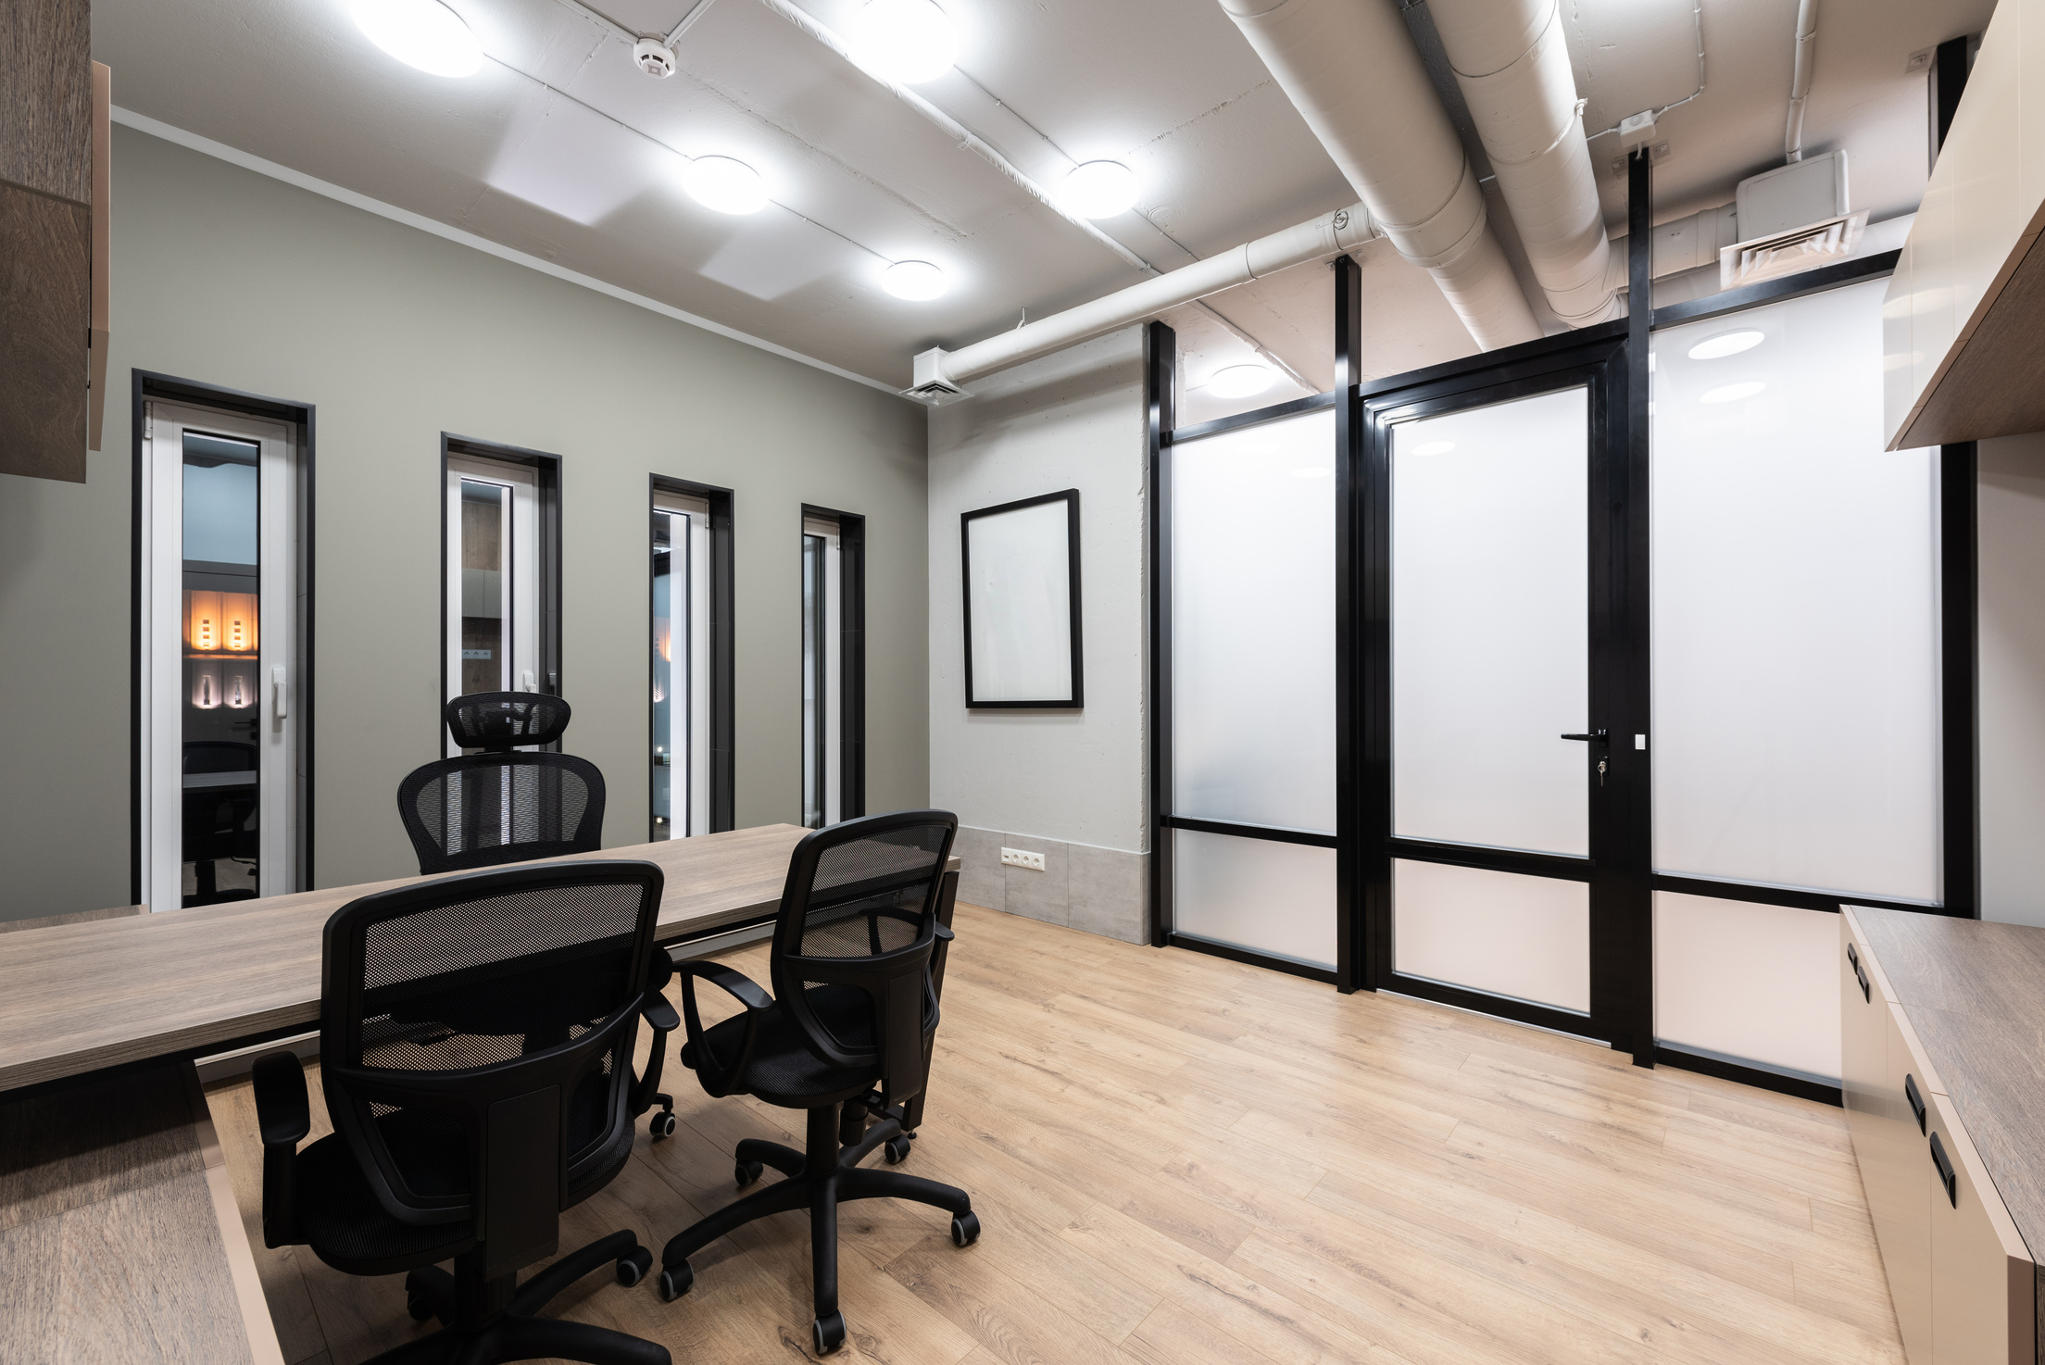
EXECUTIVE SUMMARY
📈 Luxury housing bookings show steady growth, Q2 leads.
5BHK+ dominates demand in luxury segment
🌐 Online sales emerging as the top sales channel
📊 Market remains resilient across micro-markets

Slide 3




🔧 TECH STACK
Data Cleaning & Feature Engineering
Load Clean Data into RDBMS
Power BI — Interactive Dashboard

Slide 4

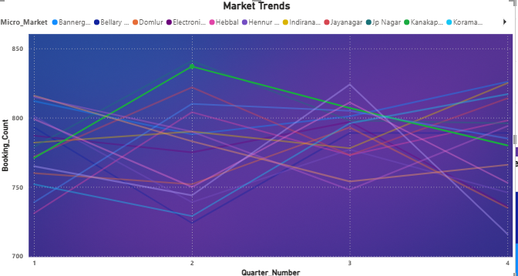
MARKET TRENDS
Trend line chart showing consistent quarterly growth in bookings

Slide 5
Business Insights
01
02
03
1. Market Trends:A line chart analysis reveals a significant surge in bookings in Whitefield and Sarjapur between Q2 and Q3. Specifically, these locations experienced a 20% increase in bookingsThis growth could be attributed to factors such as improved infrastructure, increased commercial activity, or changing residential preferences.
2. Builder Performance:Analyzing builder performance through a combination of bar charts and tables highlights key players and their strengths. While Prestige and Sobha lead in overall revenue generation, Total Environment stands out with the highest average ticket size per booking. Understanding these nuances is crucial for benchmarking and competitive analysis.
3. Amenity ImpactA scatter plot analysis demonstrates a clear correlation between amenity scores and booking conversion rates. Projects with an amenity score above 8 exhibit a 30% higher booking conversion rate on average. This underscores the importance of investing in high-quality amenities to attract potential buyers and improve conversion rates.

Slide 6
THANK YOU

